Slide 1


Data Engineering Graduation Project
AI & Data Science Track
Digital Egypt Pioneers Intiative - DEPI

Slide 2



Movie Review Sentiment Analysis and Improvement

Slide 3





TEAM
Salma Essam
Mirna Sherif
Develops interactive data visualizations using Power BI and clean the data .
Manages data acquisition processes and performs big data analysis to support comprehensive data-driven decision-making.
Gehad Emad
Focused on writing complex SQL queries for data validation and analysis.
Haneen Alaa
Handles the deployment of machine learning models and manages the integration of ML solutions into the production environment.
Alaa Atef
Responsible for designing and managing the ETL processes and overseeing the data warehousing architecture.

Slide 4
AGENDA
Introduction
data cleaning and preprocessing
SQL Queries
DATA WAREHOUSE
Big Data & INSIGHTS

Slide 5
Introduction

Slide 6



PURPOSE
NEED
DURATION
With evolving audience preferences and global competition, understanding trends, favored genres, and successful runtime combinations is essential. This analysis provides data-driven insights, helping producers make informed decisions to create more appealing and globally competitive films.
To analyze movie statistics and viewer preferences, providing valuable insights that can help producers and platforms tailor future releases to better align with audience expectations and trends.
4 Weeks

Slide 7
WHY THIS PROJECT IS NEEDED
Challenges:
Massive Dataset of Movies & Reviews: The film industry generates an overwhelming amount of data, with numerous titles and millions of reviews that are difficult to analyze manually.
Complex Viewer Preferences: Audiences have diverse tastes, making it challenging to determine which genre combinations, runtimes, and production teams resonate most across different regions.
Untapped Data Insights: Without structured analysis, valuable information about viewer preferences, genre success, and runtime efficacy remains hidden.
Solution:
Data-Driven Insights: By analyzing historical movie data and viewer feedback, our project delivers actionable insights that help improve the quality and appeal of future films.
Comprehensive Dataset Evaluation: Our analysis is capable of handling large datasets from sources like IMDb, ensuring that trends and audience reactions are accurately captured and interpreted for ongoing and future projects.

Slide 8
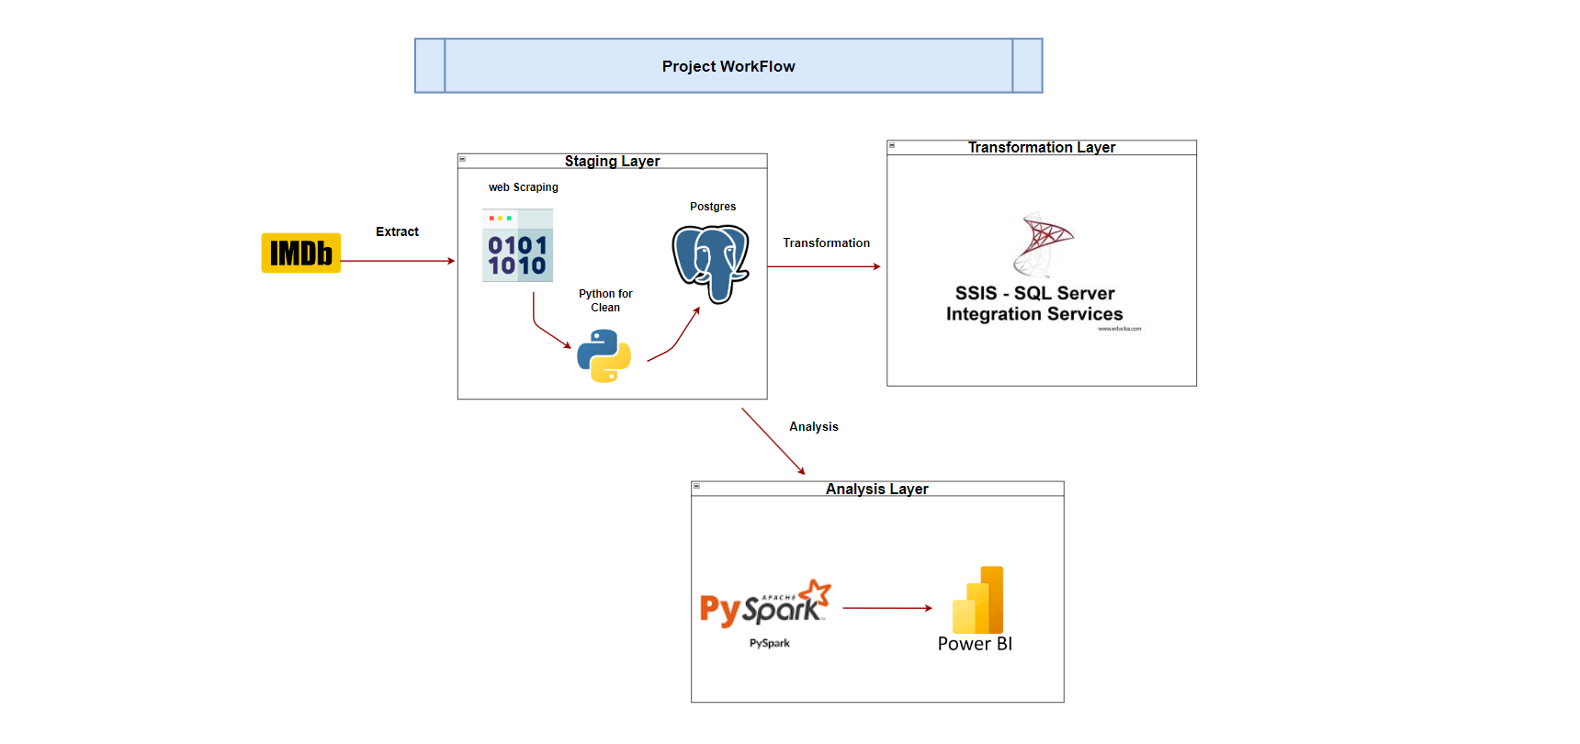
DATAFLOW

Slide 9
Web
Scrapping

Slide 10
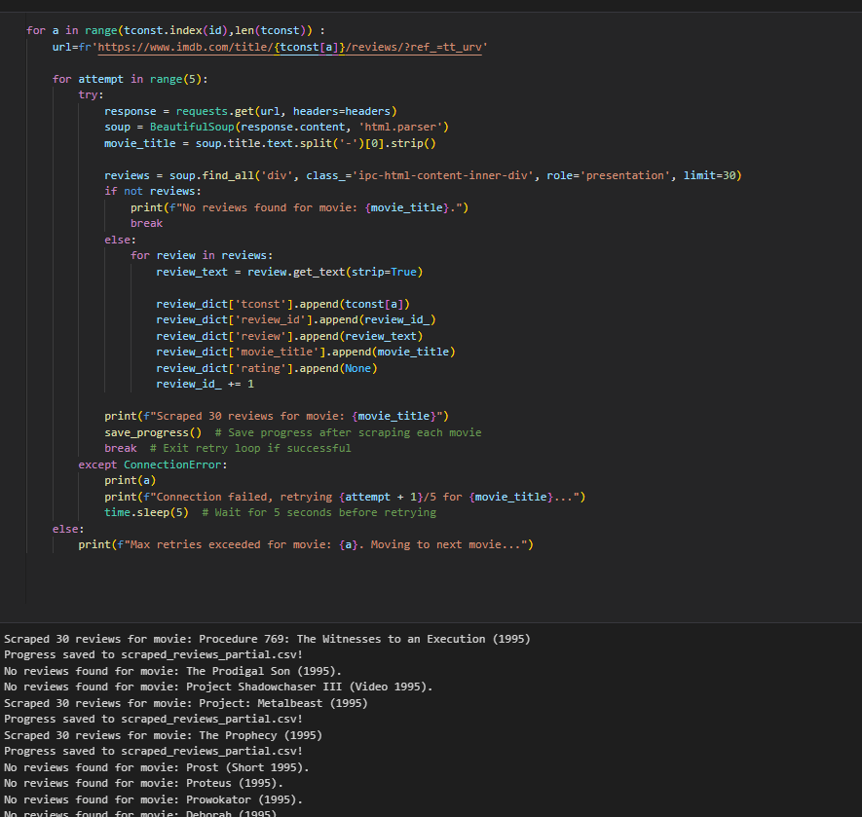

Slide 11
data cleaning and preprocessing

Slide 12
DESCRIPTION OF TABLES
akas: Contains alternative titles for movies, including fields like titleid, ordering, title, region, language, types, attributes, and isoriginaltitle.
name_basics: Holds basic information about individuals, with fields such as nconst, primaryname, birthyear, deathyear, primaryprofession, and knownfortitles.
title_akas: Similar to the akas table, it stores alternative titles with fields like titleid, ordering, title, region, language, types, attributes, and isoriginaltitle.
title_principals: Details the key cast and crew for movies, including fields like tconst, ordering, nconst, category, job, and characters.
title_basics: Contains primary information about movies, such as tconst, titletype, primarytitle, originaltitle, isadult, startyear, endyear, runtimeminutes, and genres.
reviews: Stores movie reviews, with fields like review_id, review_text, movie_title, tconst, and review_date.
title_episode: Holds episode information for TV series, including fields like tconst, parenttconst, seasonnumber, and episodenumber.
title_ratings: Contains ratings data for movies, with fields such as tconst, averagerating, and numvotes.
title_crew: Details about the crew for movies, including fields like tconst, directors, and writers.

Slide 13
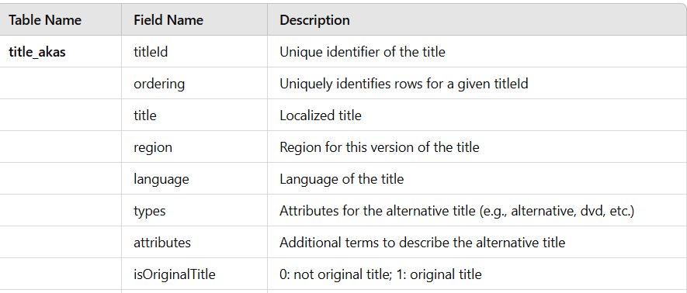
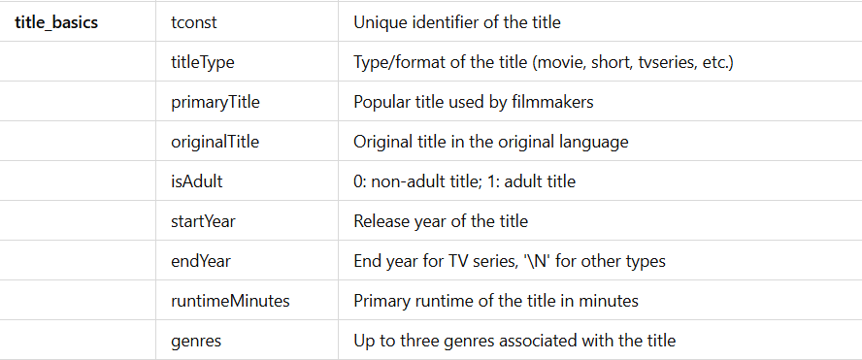
DICTIONARY:

Slide 14
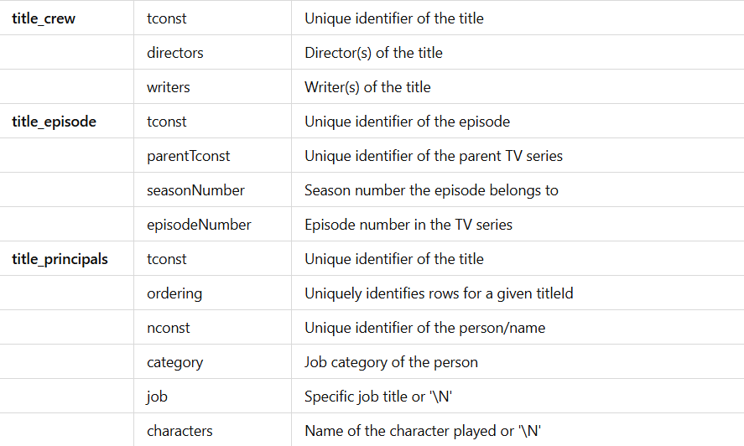
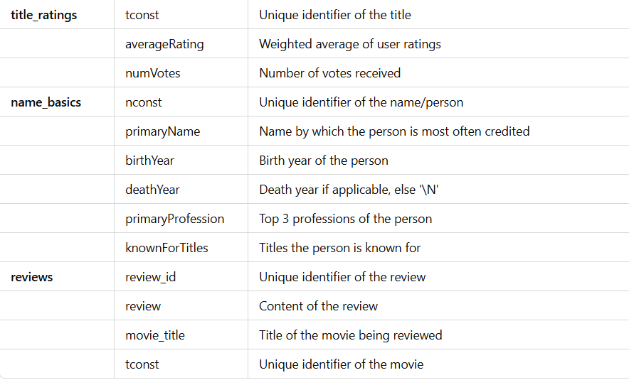
DICTIONARY:

Slide 15
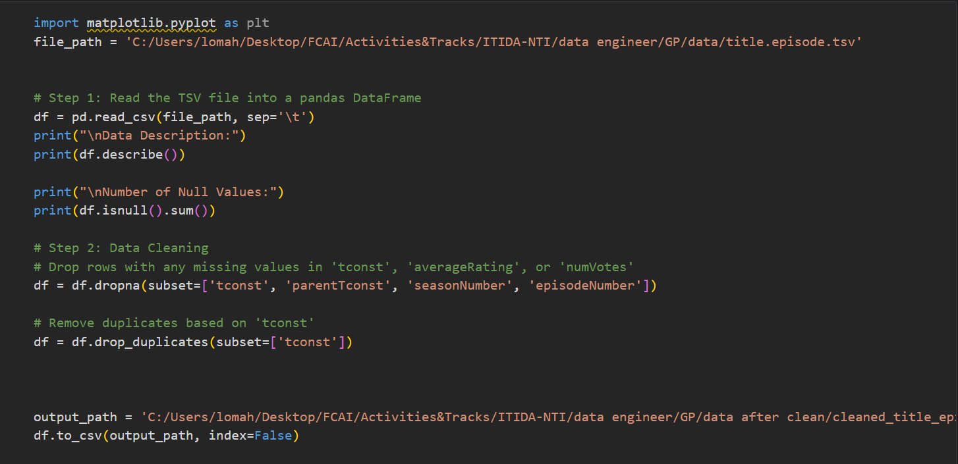
DATA CLEAN

Slide 16
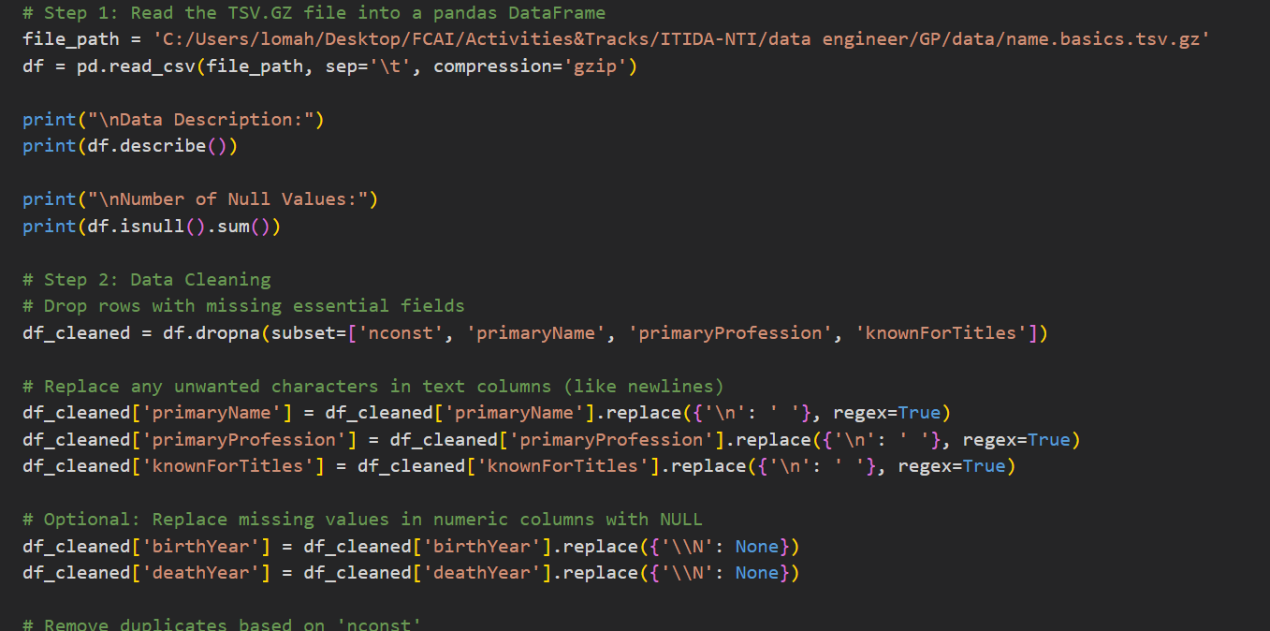
DATA CLEAN

Slide 17
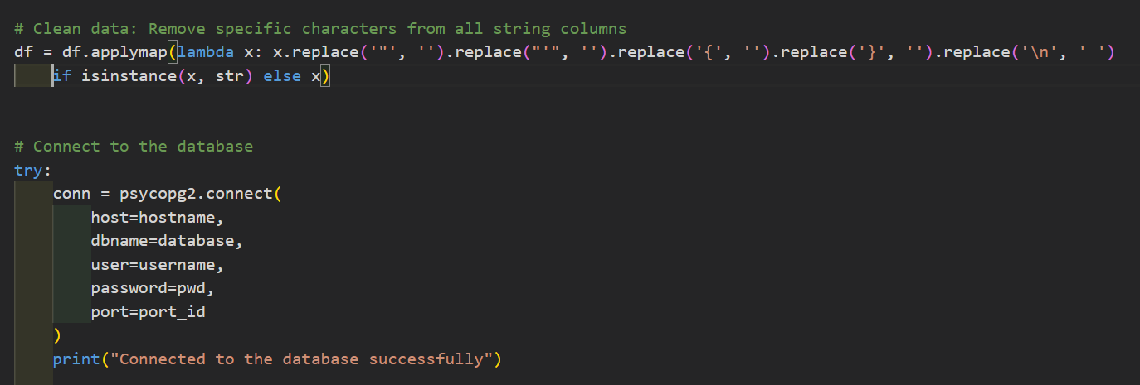
DATA CLEAN

Slide 18
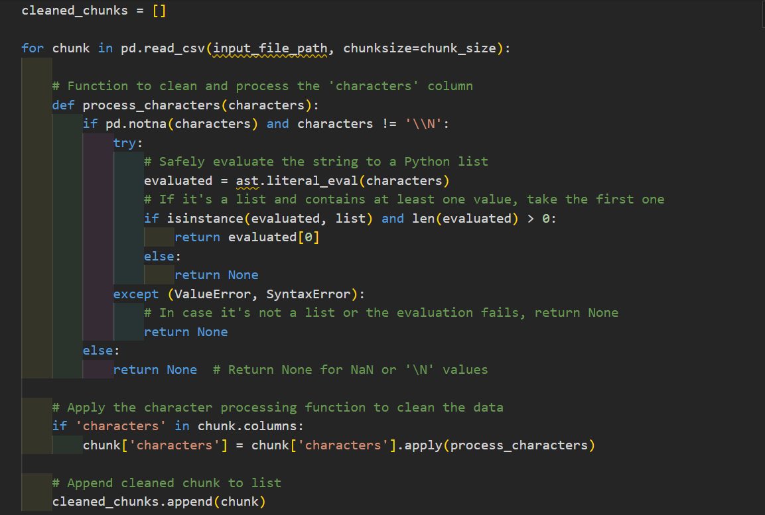
DATA CLEAN

Slide 19
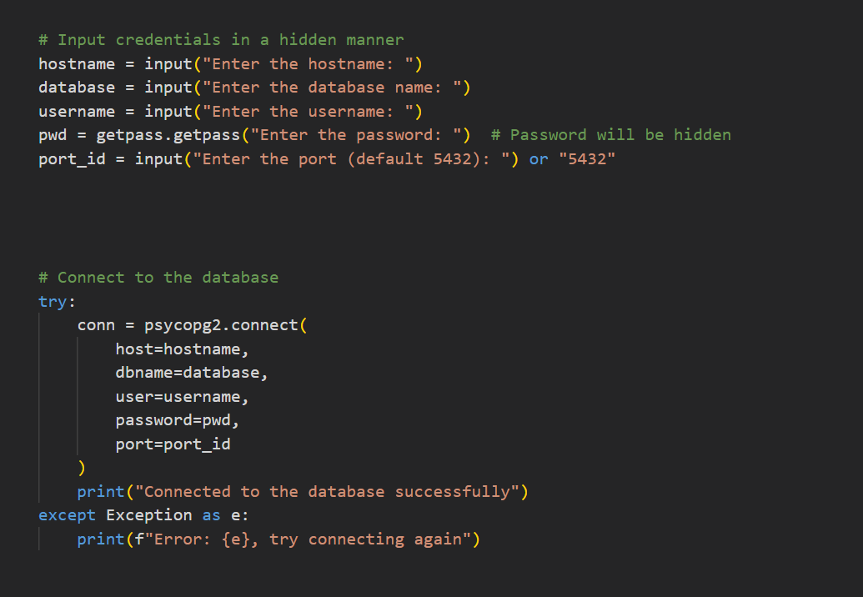
DATA CLEAN

Slide 20
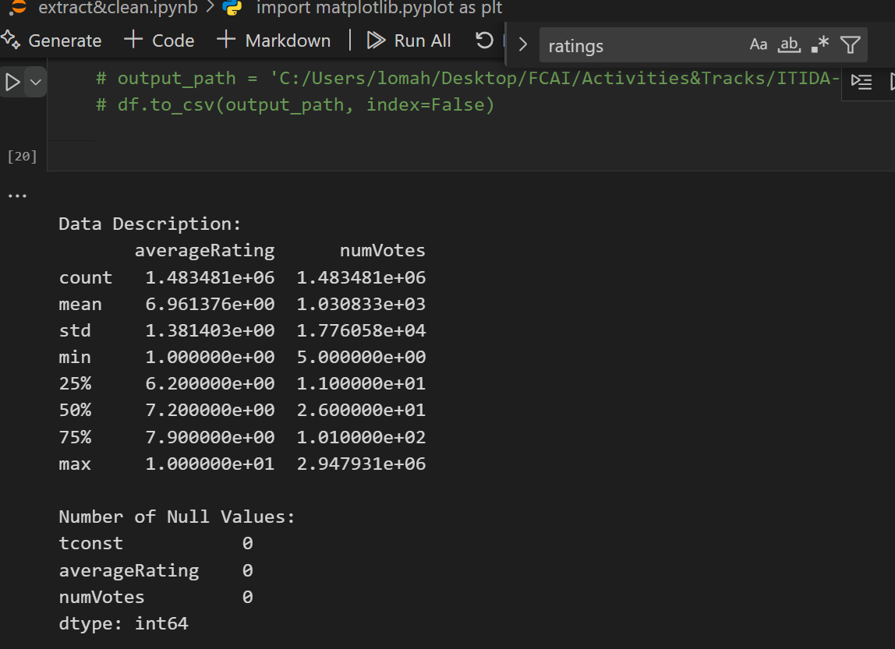
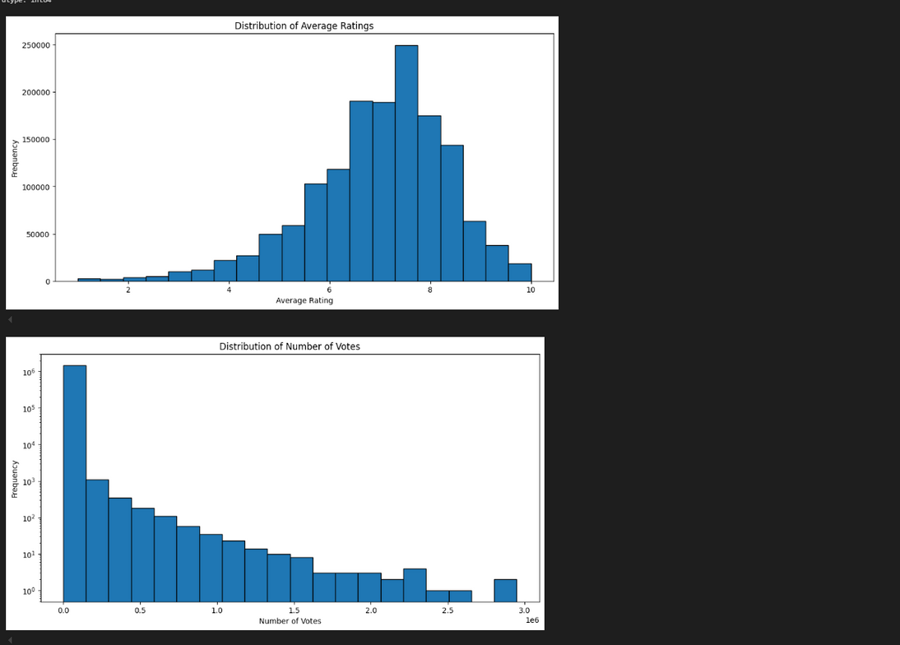
DATA CLEAN

Slide 21
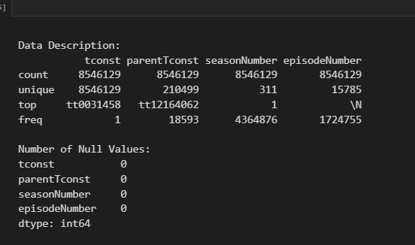
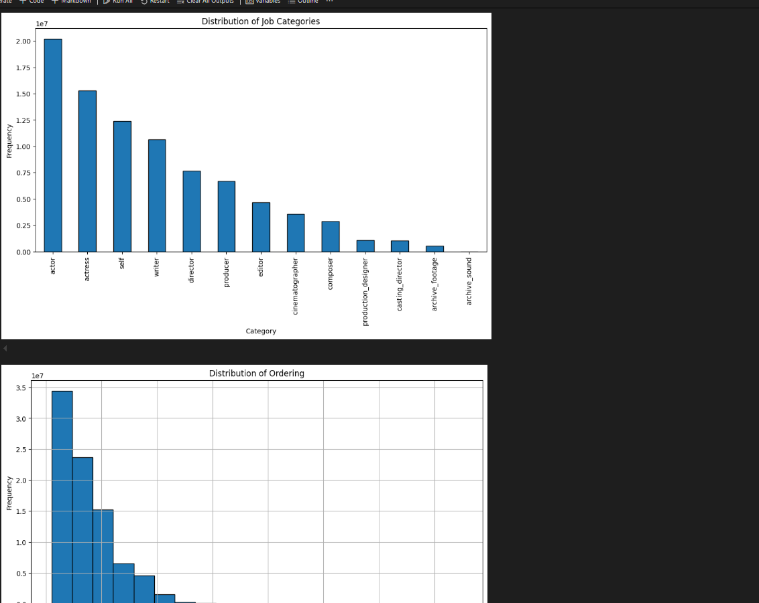
DATA CLEAN

Slide 22
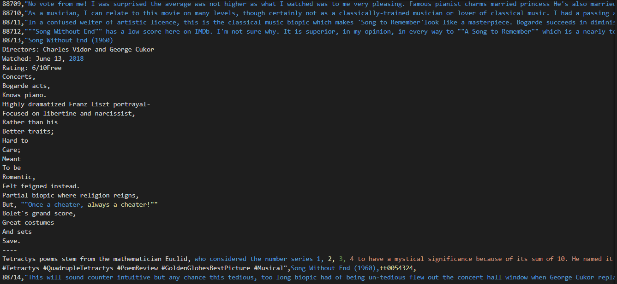
DATA CLEAN
To be cleaned

Slide 23
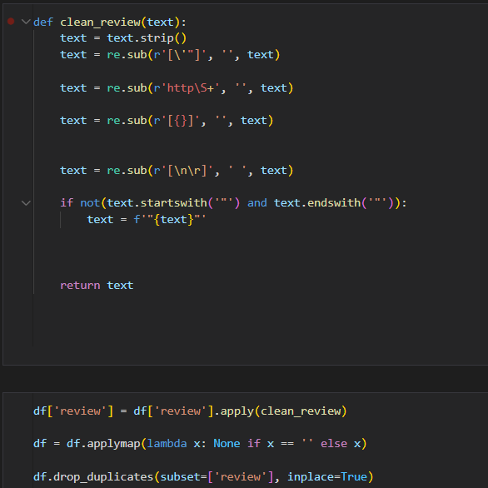
DATA CLEAN
Cleaning

Slide 24
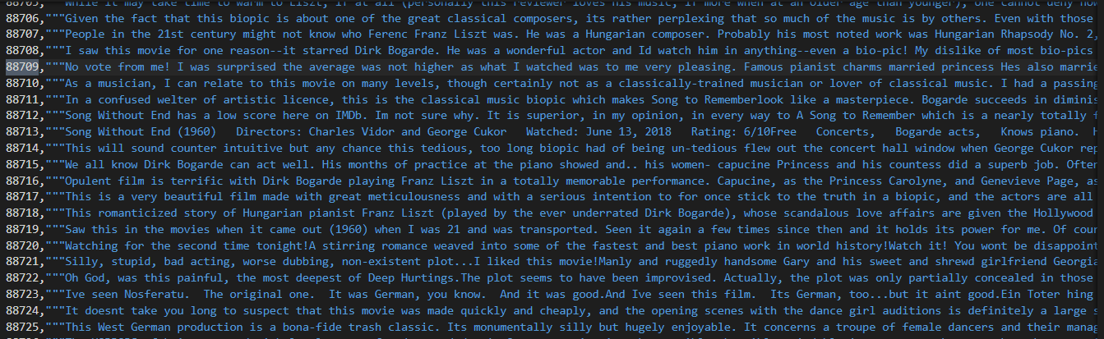
DATA CLEAN
Cleaned

Slide 25
SQL Queries

Slide 26
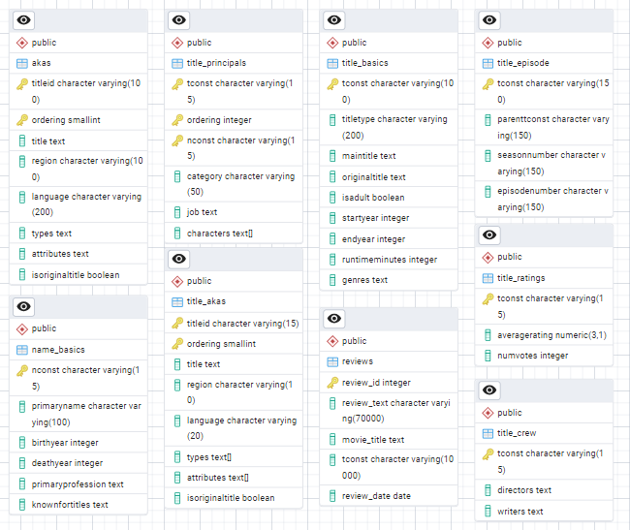
ERD FOR DATABASE

Slide 27
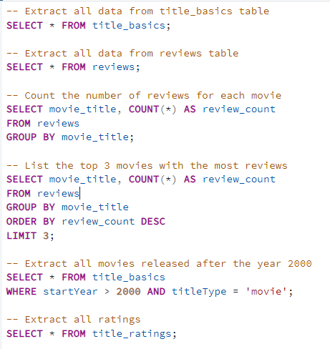
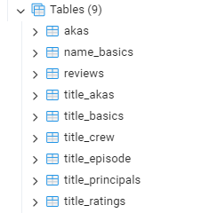

EXTRACT & ANALYZE DATA

Slide 28
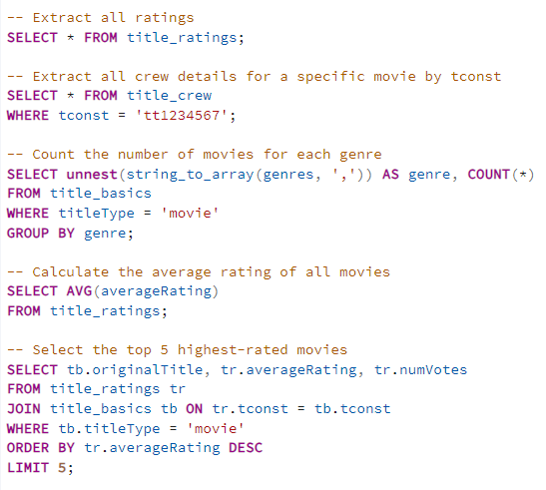
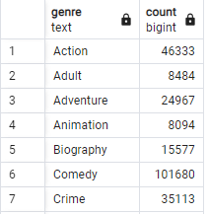
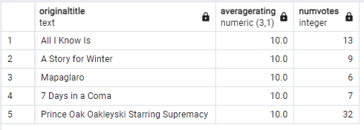
EXTRACT & ANALYZE DATA

Slide 29
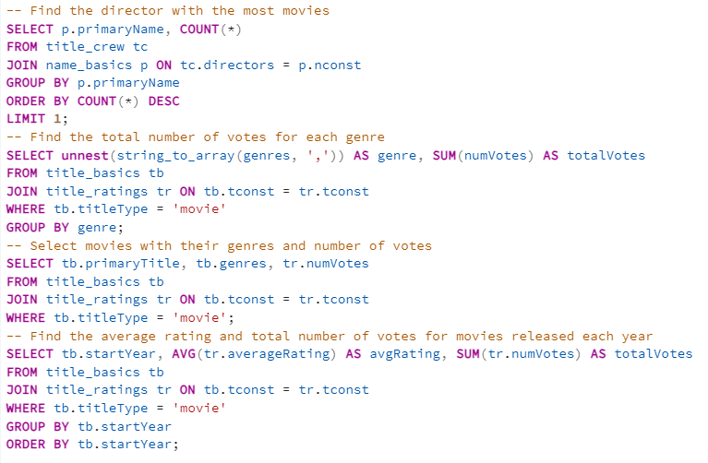
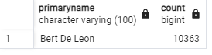
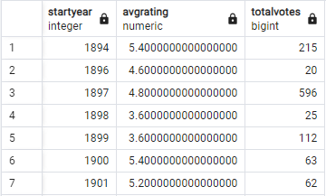
EXTRACT & ANALYZE DATA

Slide 30
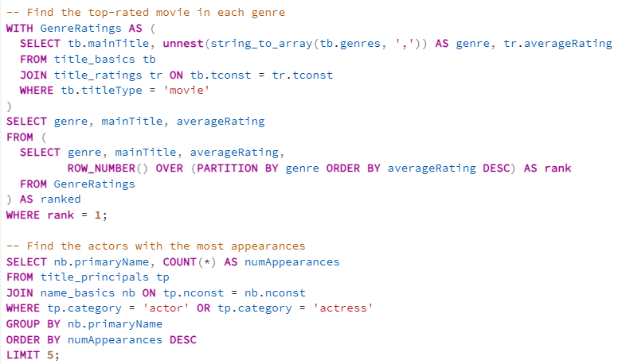
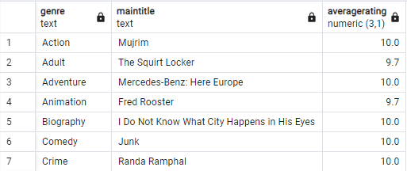
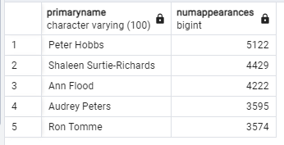
EXTRACT & ANALYZE DATA

Slide 31
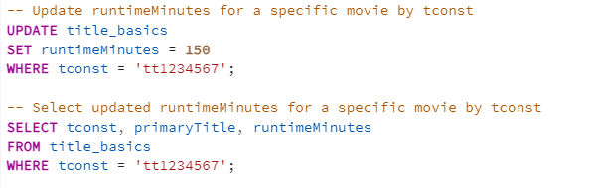
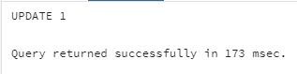
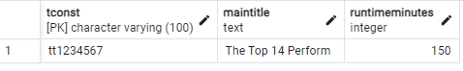
UPDATE DATA

Slide 32
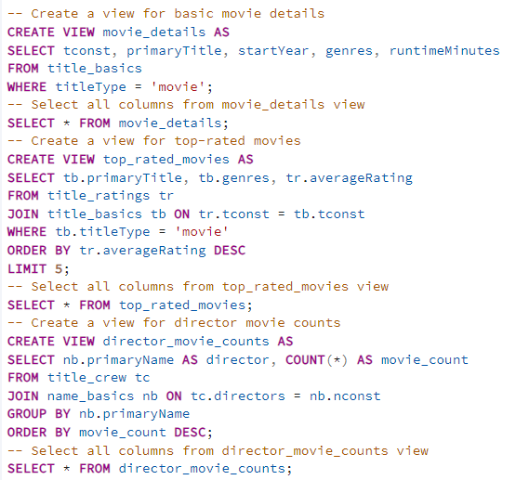
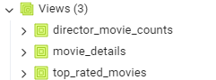
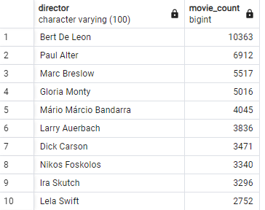
CREATING VIEWS

Slide 33
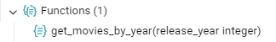
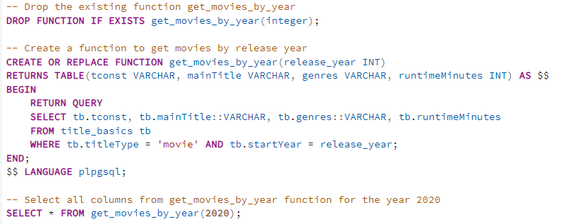
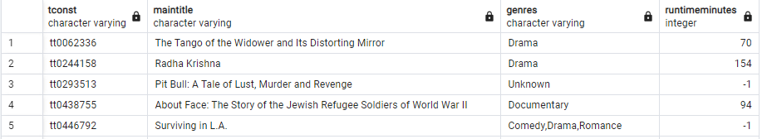
CREATING A FUNCTION

Slide 34
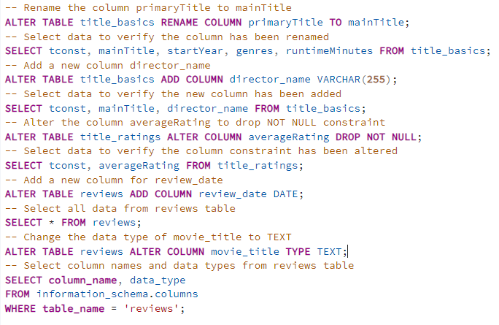
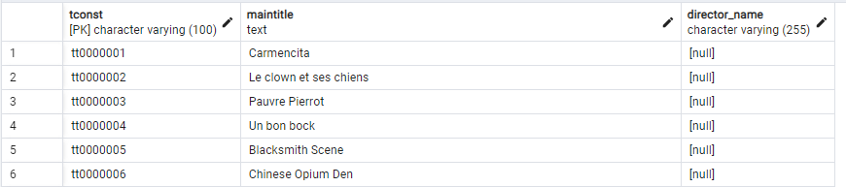
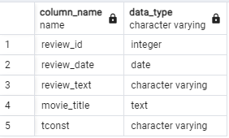
ALTERING A TABLE

Slide 35
DATA WAREHOUSE

Slide 36
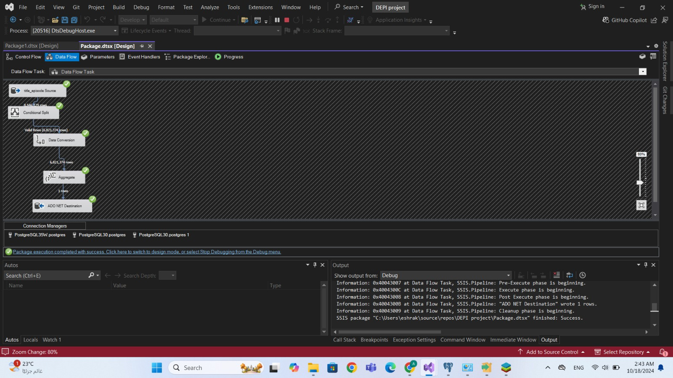
DIMENSIONS

Slide 37
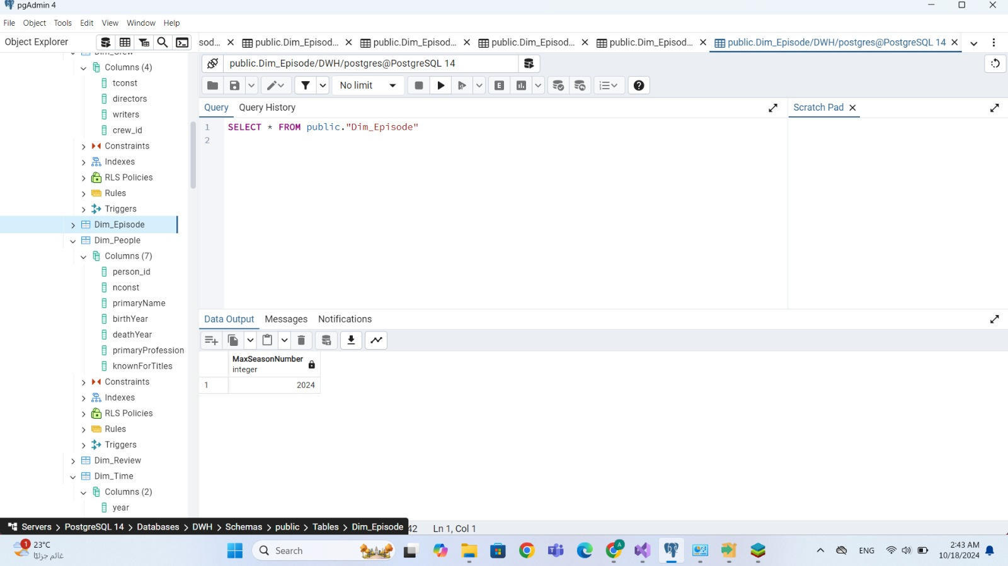
DIMENSIONS

Slide 38
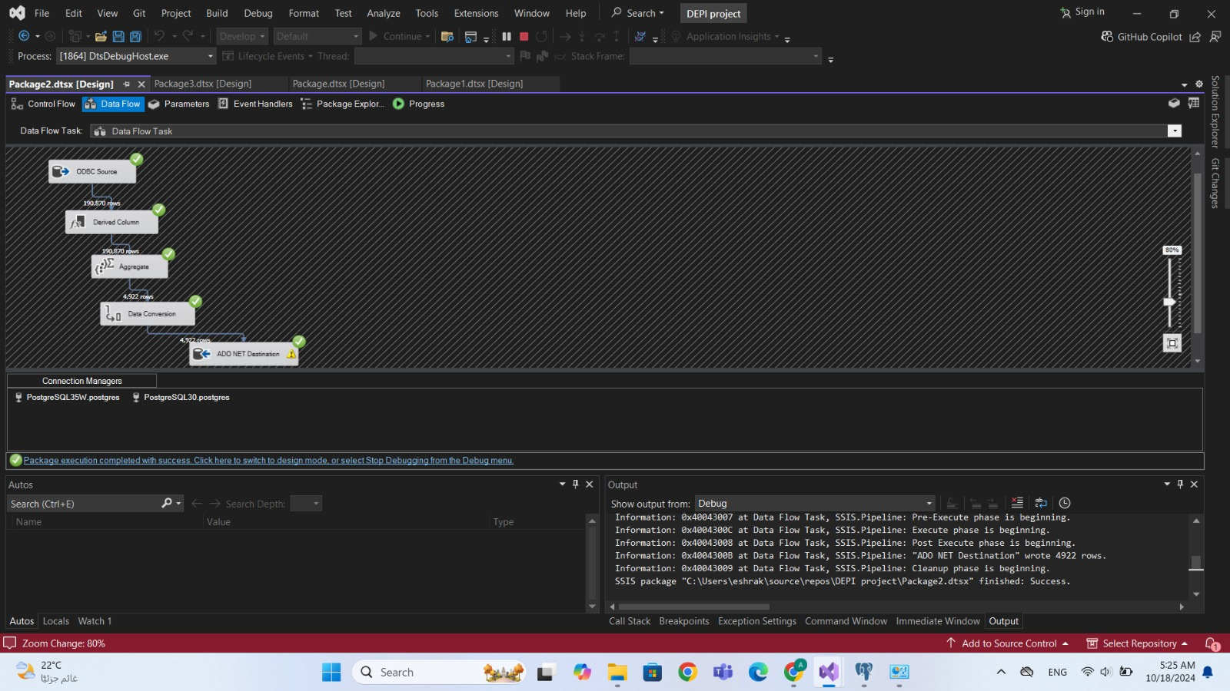
DIMENSIONS

Slide 39
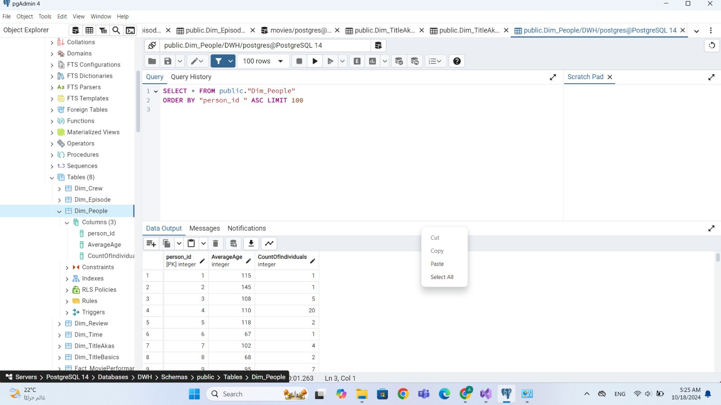
DIMENSIONS

Slide 40
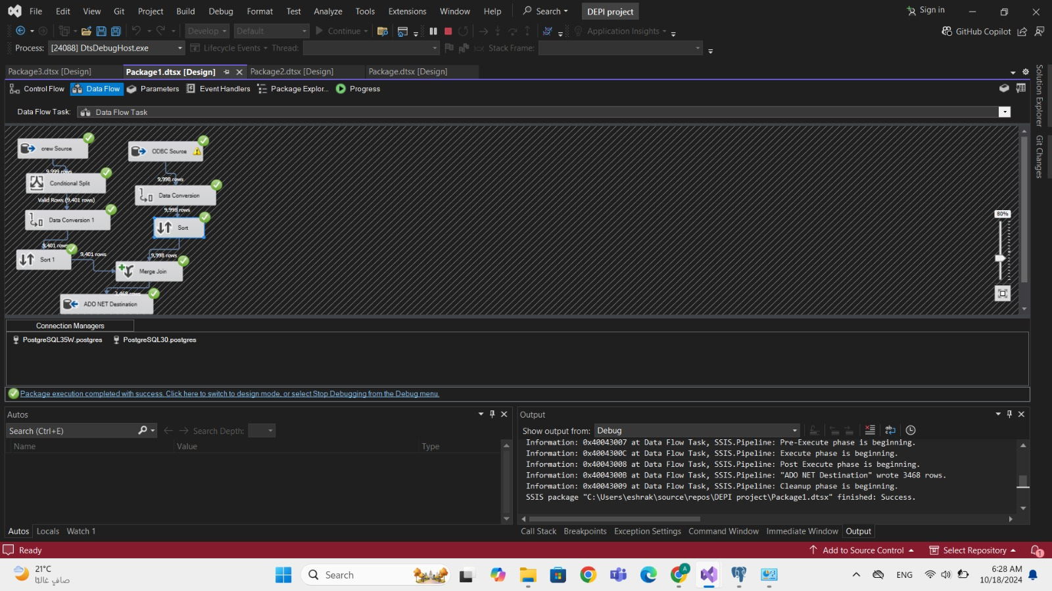
DIMENSIONS

Slide 41
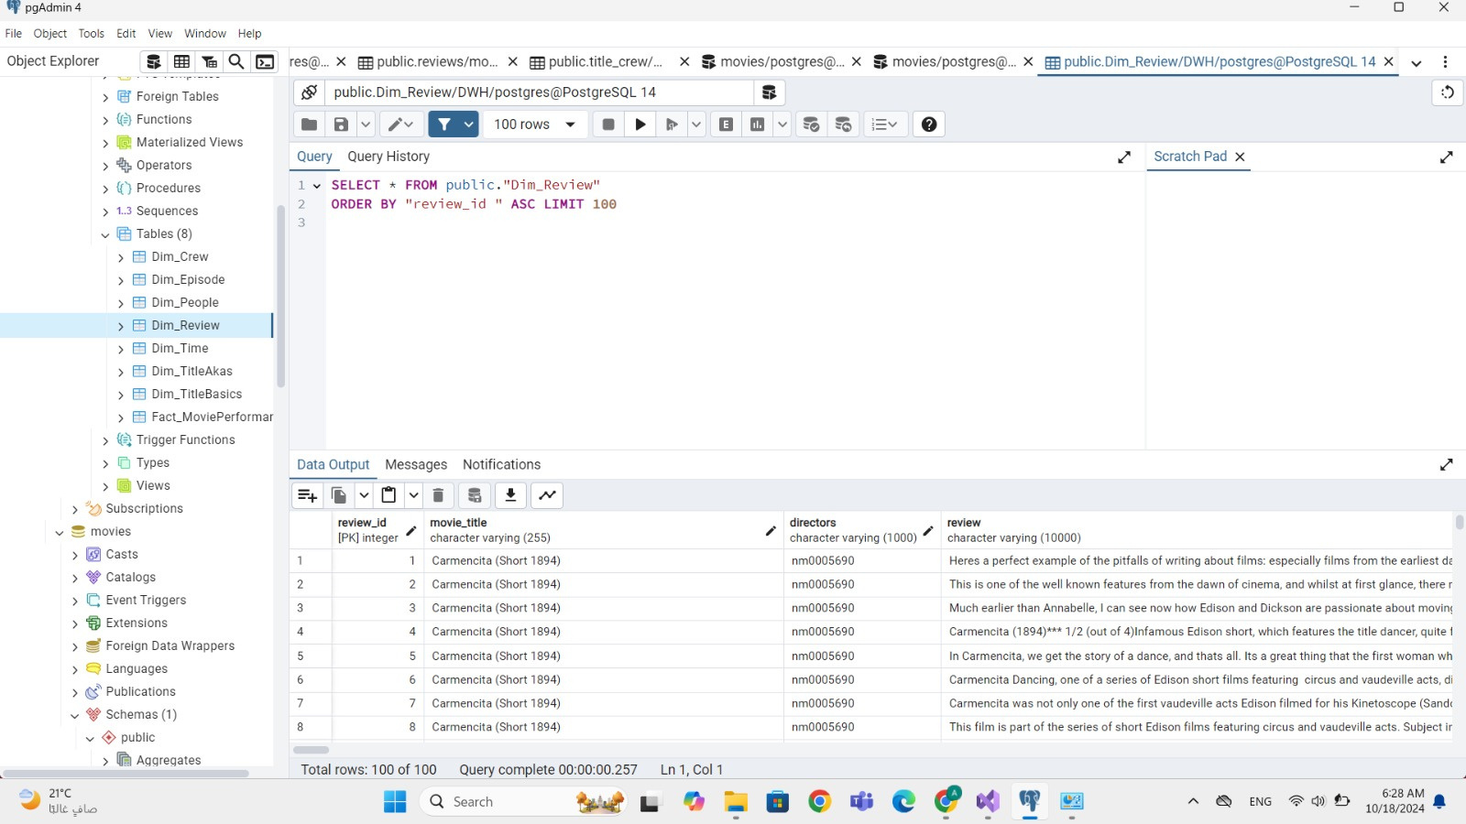
DIMENSIONS

Slide 42
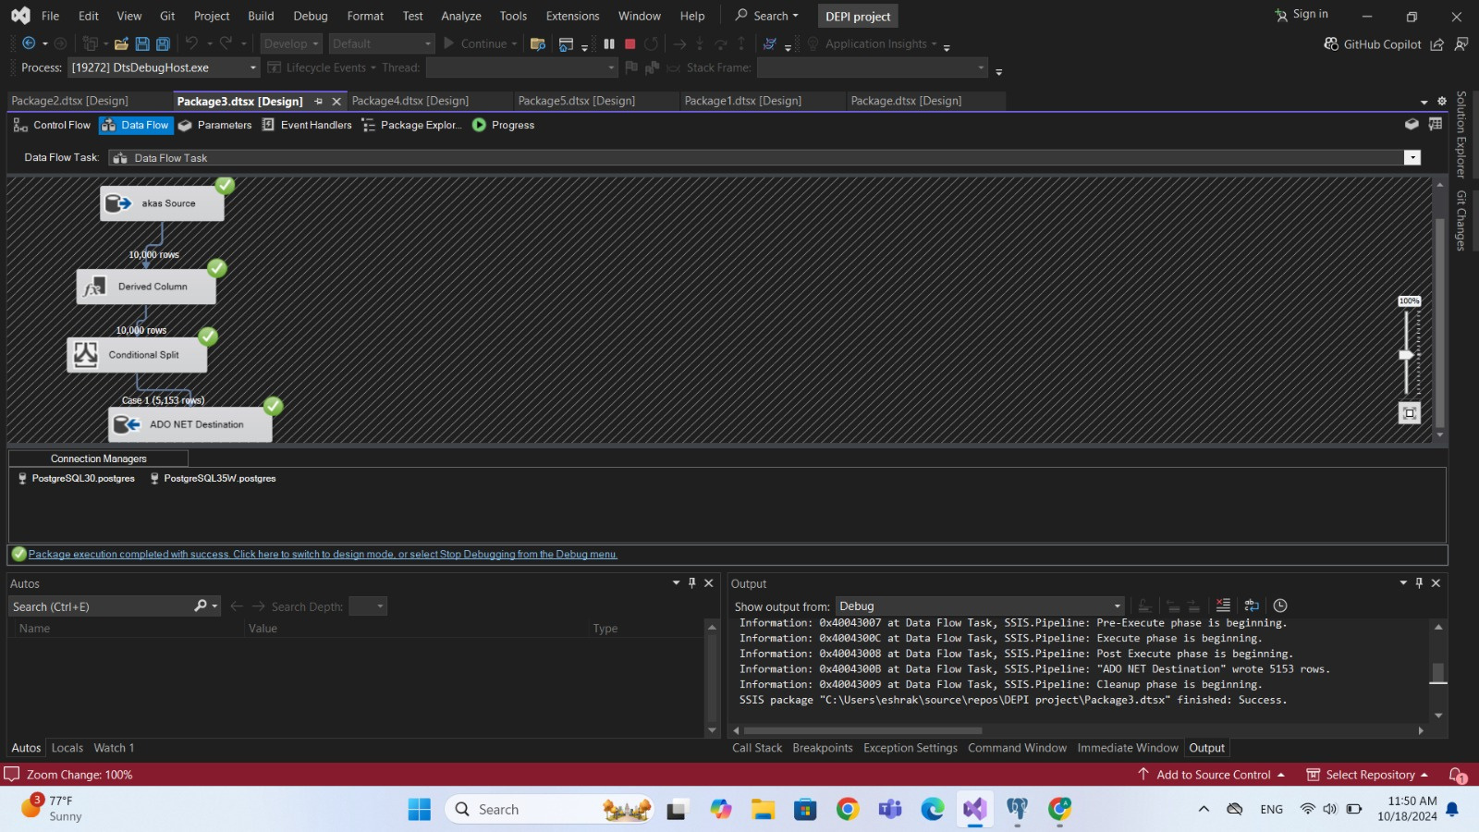
DIMENSIONS

Slide 43
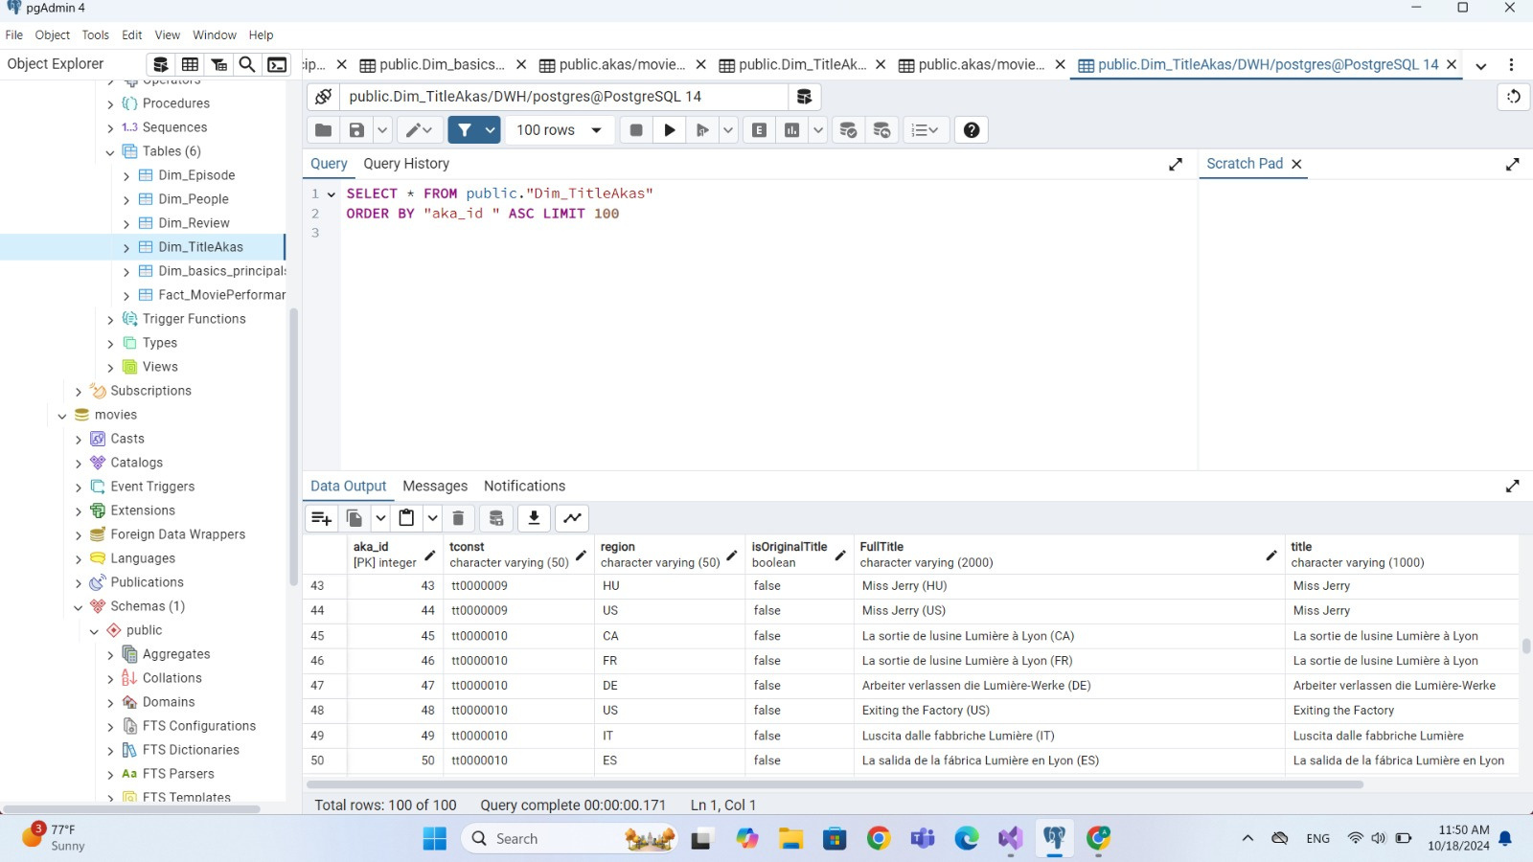
DIMENSIONS

Slide 44

DIMENSIONS

Slide 45

DIMENSIONS

Slide 46

DIMENSIONS

Slide 47

DIMENSIONS

Slide 48
BIG DATA &
INSIGHTS

Slide 49

DASHBOARDS

Slide 50

DASHBOARDS

Slide 51


ANALYSIS CODE
Max directors

Slide 52

ANALYSIS CODE
#1 Genre in region

Slide 53

ANALYSIS CODE
Most liked genre
and their preffered runtime

Slide 54

ANALYSIS CODE
Genres in trend

Slide 55

ANALYSIS CODE
Most Liked Genre Combinations

Slide 56

DASHBOARDS

Slide 57

DASHBOARDS

Slide 58

THANKS FOR YOUR ATTENTION

